Slide 1



Slide 2
It's okay to feel how you feel, and it's important to know that free support is available.​ The right support can help you get the boost you need and make tough times feel more manageable.
Are you feeling stressed, overwhelmed or just not yourself?
Are your thoughts, feelings or behaviours affecting your daily life?

Slide 3
Your mental health matters
Access free support in a way that works for you.​ Across Aotearoa New Zealand, a wide range of free mental wellbeing services are available to support you, and the people you care about.​

Slide 4
Find free, confidential mental health support in a way that suits you.
You can:​
call or text a helpline​
meet with a mental health professional​
use apps and resources that work for you.​
Free support is here. Whenever you need it.​ However you choose to access it.​

Slide 5
Talking to someone can help you feel supported when you need a boost or some guidance.

Slide 6
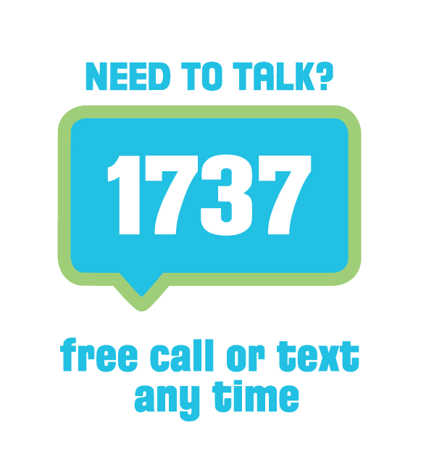
Someone to talk to
To connect with a trained counsellor at a time that suits you, free call or text 1737 (available 24/7). ​
The team: ​
offer brief emotional support​
provide self-care tips ​
connect you to other services​
offer wellbeing tools.

Slide 7
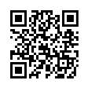
Someone to see
Ongoing support can help you work through things affecting your daily life.
You may need support with improving sleep, managing stress or anxiety, or changing habits, like drug or alcohol use.​
To meet someone face-to-face and have more time to talk, you can access free, confidential mental health support nationwide.​
For more information on how to support your mental health, or to find your nearest free mental health provider, visit: ​
wellbeingsupport.health.nz​
or scan the QR Code.​

Slide 8
Something to download
Mental wellbeing doesn’t happen by accident; it needs nurturing and protecting
Mental health apps and resources can help you understand how you're feeling and develop skills to look after yourself.​

Slide 9
Access the following free, confidential mental health tools and resources at a time that suits you.

Slide 10

Download the Groov App​
Practical, science-based guidance, whenever you need it. Instant answers to everyday questions, from managing pressure, to handling tough conversations or resetting after a big day.​
Private. Secure.​
Easy to use.​ Download today at:
groovnow.com/groov-app

Slide 11

Top Up
Simple, everyday actions proven to promote mental wellbeing.​
Paying attention to what keeps our mental health meter topped up, helps us adapt to challenges and fully enjoy the good times too.​
Learn ways to top up your wellbeing at:
​topupwellbeing.nz​

Slide 12

The Mental Health Foundation
For information on everyday actions that lift mental wellbeing, and tools that support you through tough times. ​
Access free, practical and evidence-based tools and resources that improve mental health at:​
mentalhealth.org.nz

Slide 13
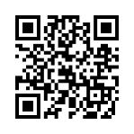

Visit wellbeingsupport.health.nz or scan the QR Code for more ways to support your own and others’ mental wellbeing – whether you’re at work, home or in the community.

